Slide 1
Time Series to Images

Slide 2
Visualization of TS Data
Basic Visualizations:
Line plots
Heatmaps
Limitations:
Difficult to capture complex patterns
Challenging to apply advanced image processing techniques
Idea:
Convert time series data into images for better pattern recognition
Use of image-based techniques for analaysis

Slide 3
Steps to Convert TS to Images
Preprocessing:
Normalize the data
Transform Techniques:
Apply the chosen conversion method
Postprocessing:
Rescale images if necessary
Apply image enhancements
Applications:
Anomaly Detection
Classification
Forecasting

Slide 4
Techniques for Conversion
Recurrence Plot:
Visualizes the times at which a state in a dynamical system recurs
Gramian Angular Field (GAF):
Encodes time series data into Gramian matrix
Markov Transition Field (MTF):
Represents transition probabilities of a Markov chain

Slide 5
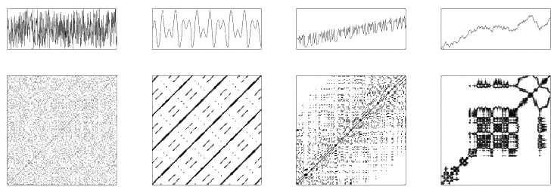
Recurrence Plot
It provides a two-dimensional graphical representation of a time series where patterns and structures in the data can be observed.

Slide 6
Steps to Convert Time Series Data to Recurrence Plot
Prepare the Time Series Data: Normalize the data
Construct the Recurrence Matrix:
Define a threshold ε to determine when two points in the time series are considered recurrent.
Create a matrix R where each element R(i, j) is determined by the following rule: 𝑅(𝑖,𝑗)=Θ(𝜖−∥𝑥(𝑖)−𝑥(𝑗)∥)
Here, x(i) and x(j) are points in the time series, and Θ is the Heaviside step function.
Generate the Recurrence Plot:
The recurrence matrix R is visualized as a binary image where R(i, j) = 1 is represented as a black dot (recurrence), and R(i, j) = 0 is represented as a white dot (no recurrence).
The result is a symmetric matrix with diagonal lines (line of identity) and possible off-diagonal structures.

Slide 7
Interpretation of Recurrence Plot
Diagonal Lines: Indicate periods where the system's behavior is similar over time.
Vertical and Horizontal Lines: Indicate states that persist over time.
Isolated Points: Represent rare states or outliers.
Homogeneous Regions: Indicate stable states or trends in the time series.

Slide 8
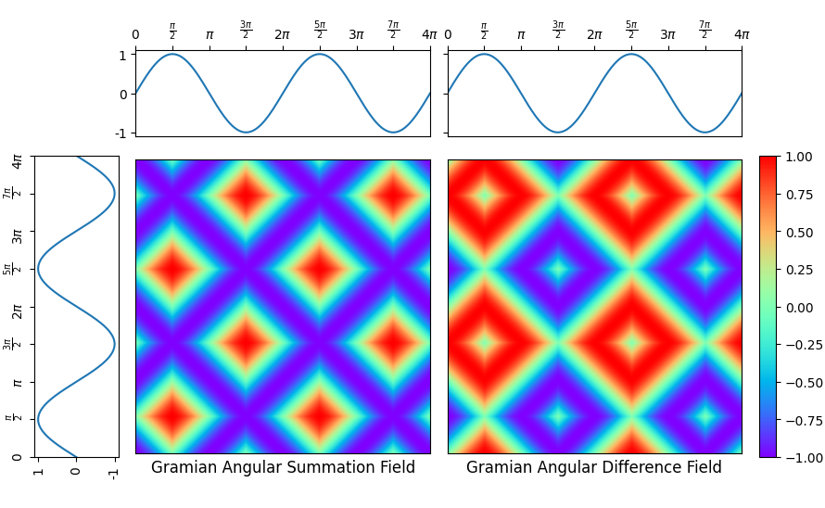
Gramian Angular Field (GAF)
The Gramian Angular Field (GAF) is a method for encoding time series data into a matrix (image) that preserves temporal dependencies and transforms the temporal information into a spatial domain.

Slide 9
Steps to Convert Time Series Data to GAF
Normalize the Time Series Data:
Normalize the data to the range [−1,1][−1,1] to ensure consistency.
Transform the Time Series Data into Polar Coordinates:
Convert the normalized time series into angular values using the cosine function. This maps the data to angles in the range [0,𝜋][0,π].
Compute the Gramian Angular Field:
Generate the GAF by computing the cosine similarity between each pair of points in the time series.
There are two types of GAF: the Gramian Angular Summation Field (GASF) and the Gramian Angular Difference Field (GADF).
GASF encodes the time series data into a matrix where each element represents the cosine of the sum of angles between pairs of time points.
GADF encodes the time series data into a matrix where each element represents the sine of the difference between angles of pairs of time points.

Slide 10
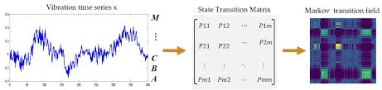
Markov Transition Field
The Markov Transition Field (MTF) is a method that encodes time series data into a two-dimensional matrix (image) by capturing the transition probabilities of a Markov chain defined over the time series.

Slide 11
Steps to Convert Time Series Data to MTF
Discretize the Time Series Data:
Discretize the continuous time series data into a finite number of states. This can be done using techniques like quantile bins or k-means clustering.
Construct the Markov Transition Matrix:
Create a transition matrix where each element represents the probability of transitioning from one state to another in the discretized time series.
Generate the Markov Transition Field:
Map the time series to its states and create the MTF by replacing each point in the time series with the corresponding transition probabilities from the Markov transition matrix.
MTF Representation: Each element in the MTF represents the probability of transitioning from one state to another at each time step in the time series.
Temporal Dynamics: The MTF captures the temporal dynamics and probabilistic transitions, providing a comprehensive view of the underlying process governing the time series.

Slide 12
Technique | Advantages | Disadvantages | Applications
Recurrence Plot (RP) | Captures recurrences, visual pattern recognition, applicable to short/long series | Threshold sensitivity, binary representation, computational complexity | Anomaly detection, periodicity analysis, chaotic systems
Gramian Angular Field (GAF) | Preserves temporal dependency, rich representation, image-based analysis | Normalization requirement, complex transformation | Classification, forecasting, pattern recognition
Markov Transition Field (MTF) | Captures transition probabilities, rich temporal information, image-based analysis | Discretization sensitivity, complexity | Anomaly detection, behavior analysis, temporal dynamics

Slide 13
Advantages and Challenges of Conversion to Images
Advantages
Challenges
Enhanced Pattern Recognition
Utilization of Image Processing Techniques like CNN
Improved Model Performance
Importance of high-quality data
Need for significant processing power
Choosing the appropriate conversion method

Slide 14
References
Artemios-Anargyros Semenoglou ∗, Evangelos Spiliotis, Vassilios Assimakopoulos, Image-based time series forecasting: A deep convolutional neural network approach
Omer Berat Sezer∗, Ahmet Murat Ozbayoglu, Algorithmic financial trading with deep convolutional neuralnetworks: Time series to image conversion approach
Eckmann, J. P., Kamphorst, S. O., & Ruelle, D. (1987). Recurrence Plots of Dynamical Systems. Europhysics Letters (EPL), 4(9), 973-977.
Wang, Z., Yan, W., & Oates, T. (2015). Imaging Time-Series to Improve Classification and Imputation. Proceedings of the 24th International Joint Conference on Artificial Intelligence (IJCAI), 3939-3945.
Wang, Z., & Oates, T. (2015). Encoding Time Series as Images for Visual Inspection and Classification Using Tiled Convolutional Neural Networks. Proceedings of the 29th AAAI Conference on Artificial Intelligence, 3939-3945.

